Slide 1
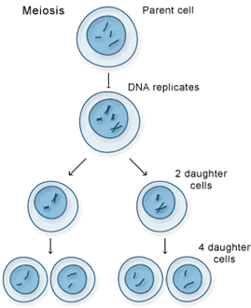
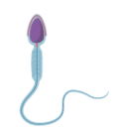
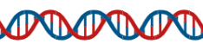


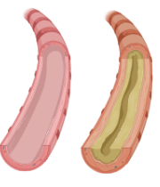
B6 – Inheritance, Variation and Evolution
Asexual vs Sexual Reproduction
Meiosis
Sex determination
Asexual
Sexual
One parent,
No gametes,
Genetically identical offspring,
Only mitosis involved.
Gametes in animals:
Egg and sperm.
Gametes in plants:
Egg and pollen.
Female = XX
Male = XY
father
DNA is copied
X
Y
Two parents,
Mixing of genetic information,
Meiosis involved.
X
XX
XY
DNA and the Genome
divides twice
mother
Double stranded
Double helix
Polymer
X
XX
XY
unique gametes
(half the number of chromosomes)
Gene – a small section of DNA on a chromosome that codes for a particular sequence of amino acids, to make a protein.
Genetic Inheritance
Allele | A form or version of a gene.
Dominant | Only one copy of the allele is needed for the trait to be expressed. (CAPITAL)
Recessive | Two copies of the alleles are needed for the trait to be expressed. (lowercase)
Homozygous | Two of the same allele.
Heterozygous | Two different alleles.
Genotype | The combination of alleles in the genome.
Phenotype | The physical expression of the genotype.
Most characteristics - multiple genes interacting.
Single gene control – fur colour in mice and colour blindness in humans.
Human Genome Research
search for genes linked to different types of disease
understanding and treatment of inherited disorders
use in tracing human migration patterns from the past.
father
Inherited Disorders
b
b
Polydactyly
Dominant allele
Extra fingers or toes
healthy airway
CF
airway
B
Bb
Bb
Cystic Fibrosis
Recessive allele
Disorder of cell membranes (excess mucus production)
mother
A heterozygous mother and a homozygous blue eyed father have a child, the probability of having a child with blue eyes is 50%.
b
bb
bb

Slide 2
B6 – Inheritance, Variation and Evolution
Asexual vs Sexual Reproduction
Meiosis
Sex determination
How many parents are needed for sexual reproduction?
Which type of cell division is needed for sexual reproduction?
How many times does the cell divide in meiosis?
What type of cells are produced?
What happens to the number of chromosomes in the new (daughter cells)?
What happens in the first step of meiosis?
What are the male sex chromosomes?
What are the female sex chromosomes?
Prove that the chance of having a son is 50%?
DNA and the Genome
What is the shape of DNA described as?
Why is it important to study the human genome?
Genetic Inheritance
What does heterozygous mean?
Determine the chance of a man that is heterozygous for hair colour and a red-haired woman have a red haired child. (B = brown, b = red).
What does genotype mean?
What does dominant mean?
Inherited Disorders
What does polydactyly cause?
What type of allele causes polydactyly?
What does cystic fibrosis cause?
What type of allele causes cystic fibrosis?

Slide 3
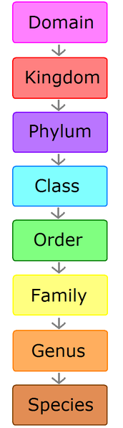
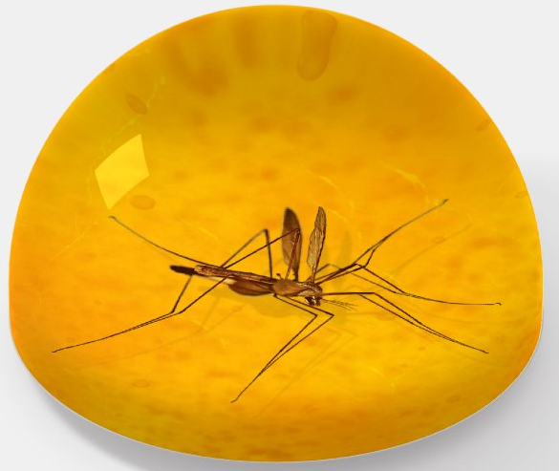
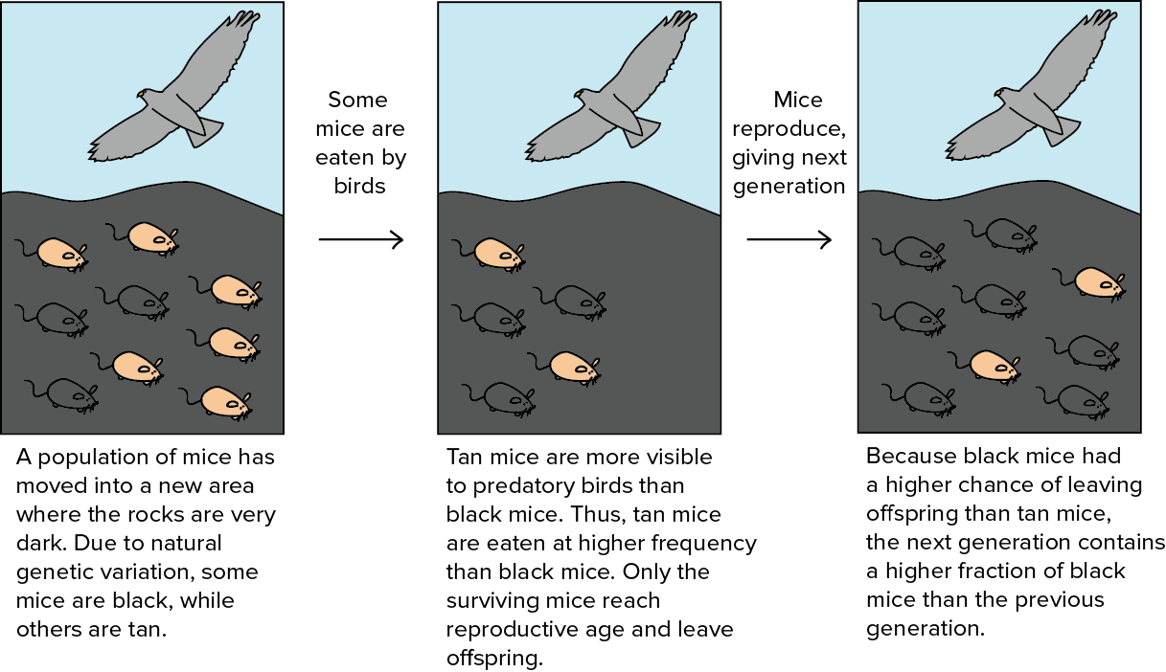
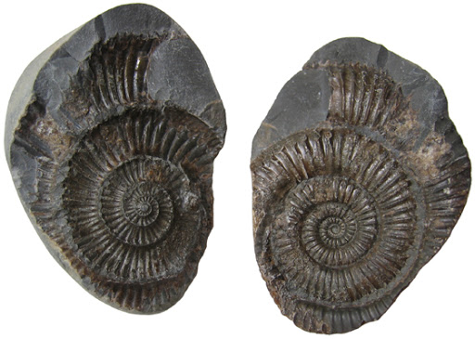
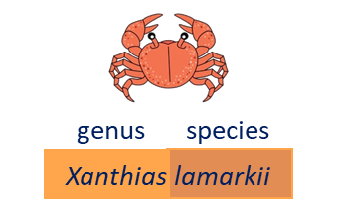
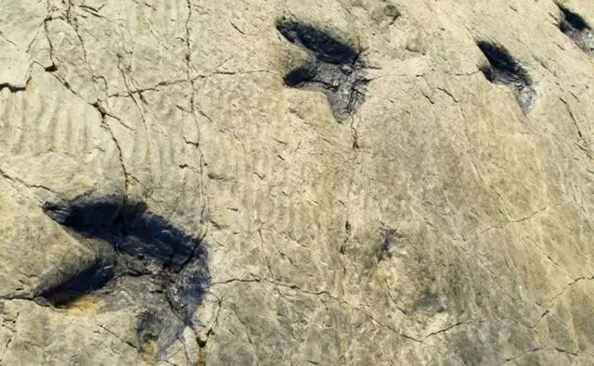
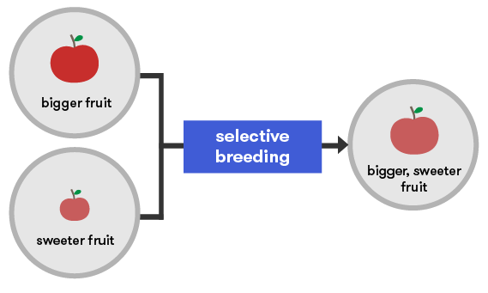
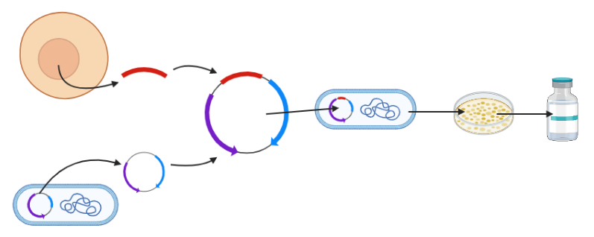
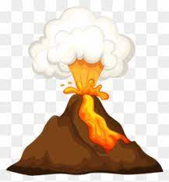
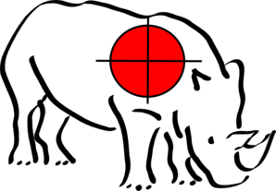
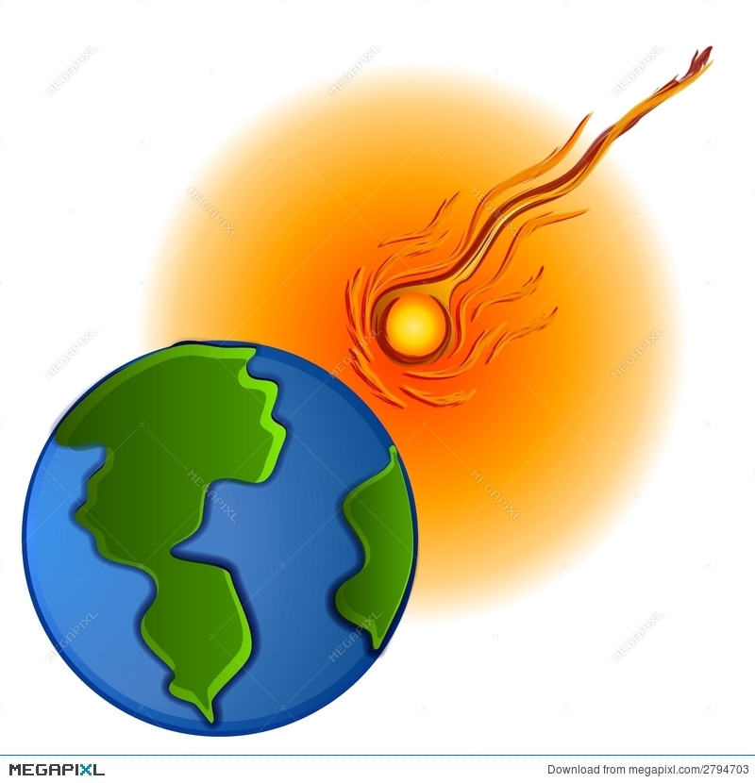
B6 – Inheritance, Variation and Evolution
Variation
Evolution
Fossils
Classification
Controlled by:
Genetic,
Environmental,
Combination of factors.
Variation.
Due to mutation.
Those suited to the environment, likely to survive and reproduce.
The generation after generation, the population changes.
Remains of organisms from millions of years ago.
Carl Linnaeus developed this classification system. The binomial name is made from the genus and species names.
Conditions for decay are absent – ice or amber.
Mutations
A change in the sequence of DNA.
Most have no effect on phenotype.
Parts of the organism are replaced by minerals as they decay.
Pebble crab
Selective Breeding
Preserved traces of organisms, such as footprints, burrows and rootlet traces.
Choose parents with the desired characteristic from a mixed population.
They are bred together.
From the offspring those with the desired characteristic are bred together.
This continues over many generations until all offspring show desired characteristic.
Resistant Bacteria
Bacteria evolve rapidly – they reproduce at a fast rate.
Early life forms were soft-bodied – therefore no fossils.
Helps us understand how organisms have changed over time.
Reduce resistance:
Doctors not to prescribe antibiotics inappropriately.
Complete their antibiotic courses.
Restricted agricultural use.
Genetic Engineering
Advantages | Disadvantages
GM plants to increase food supply. Treat diseases such as Type II diabetes. | Toxin build up from GM plants. Only used in short term so long term effects unknown.
Extinction
New disease
New predators (and hunting)
New, better competitors.
Climate change
Massive volcanic eruption
Collision between asteroid and the Earth.
human cell
insulin gene
grow in culture
HT Only
Enzymes isolate the required gene; gene is inserted into vector.
Vector is used to insert the gene into required cells.
Genes transferred to cells of animals, plants or microbes at early stage in development.
Plasmid now contains gene and is placed back into bacterial cell
extract insulin
bacterial cell

Slide 4
B6 – Inheritance, Variation and Evolution
Variation
Evolution
Fossils
Classification
Oyster Mushroom = Pleurotus ostreatus
What is a mutation?
Name 3 ways variation occurs.
Describe how giraffes evolved by natural selection to have long necks.
What are the three types of fossils?
Why are fossils useful to scientists?
Kingdom
 | Basidiomycota
Class | Agaricomycetes
 | Agaricales
Family | Pleurotaceae
Selective Breeding
Describe how you could selective breed strawberry plants to make them bigger and taste better.
Resistant Bacteria
How could we reduce antibiotic resistance in bacteria?
Genetic Engineering
Extinction
What is an advantage of using genetic engineering?
What is a disadvantage of using genetic engineering?
HT Only – Describe how a plant cell could be genetically engineered to be resistant to a weed killer.
What is extinction?
Describe 3 ways extinction could occur.

Slide 5
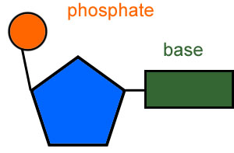
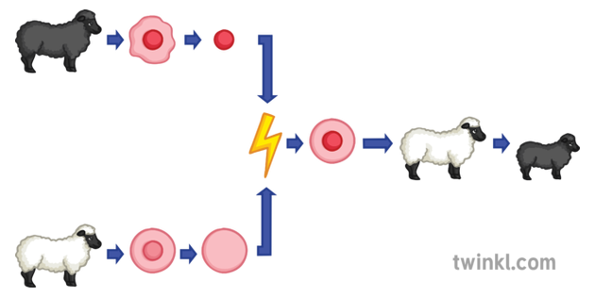
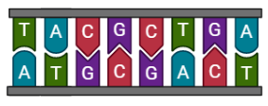

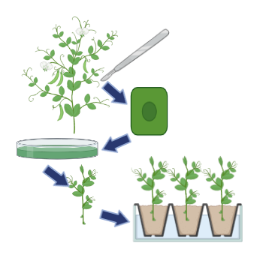
B6 – Inheritance, Variation and Evolution
Monomer
DNA Structure
Cloning
Adult Cell Cloning
Theory of Evolution
(Also see DNA and the Genome)
Darwin
Wrote ‘On the Origin of Species’ proposing a new theory – Natural Selection.
Was considered controversial because:
It challenged the idea that God made all living things.
Insufficient evidence.
Genes had not been discovered.
3 bases code for 1 amino acid, to make a protein.
If a bases changes (mutation), it could change the amino acid.
If the amino acid changes, it could make a different protein.
sugar
Bases can be A, T, C or G.
Wallace
Nucleus if taken from cell of organism you want to clone.
Nucleus is removed (and discarded) from an egg cell.
The desired nucleus is placed into the empty egg cell and given an electric shock (stimulates mitosis).
Embryo then placed in host uterus.
Worked with Darwin on his idea of Natural Selection.
Researched speciation and warning coloration.
If protein is made incorrectly it could result in:
Enzyme with denatured active site.
Hormone that doesn’t work.
Structural proteins that don’t support tissues (e.g. collagen).
Mendel
Carried out breeding experiments with pea plants.
His work led to the ‘gene theory’ once the DNA structure was discovered.
Cuttings
Old and simple method.
Many identical plants from one parent plant.
Asexual Vs Sexual Reproduction – Advantages and Disadvantages
Speciation
Separation/isolation of two or ore groups of an organism.
Variation within each group.
Due to mutation.
Those suited to the environment, likely to survive and reproduce.
This will be different in each separate environment.
The generation after generation, the population changes.
Separated groups become so different to each other they can no longer produce fertile offspring (are now a different species).
Advantages of Asexual | Advantages of Sexual
Only one parent needed. Time and energy efficient. Faster. Many identical offspring produced when conditions favourable. | Variation in offspring. Survival advantage if environment changes. Selective breeding possible to increase food production.
Tissue Culture
Small groups of cells from part of a plant to grow identical new plants.
This is important for preserving rare plant species or commercially in nurseries.
Some organisms do both!

Slide 6
B6 – Inheritance, Variation and Evolution
DNA Structure
Cloning
Theory of Evolution
What are the three parts of a DNA monomer?
How many bases cause for 1 amino acid?
Which letters are used for the four bases?
What might be the consequence if there is a mutation in a gene to make an enzyme?
Describe the process of adult cell cloning.
What is a cutting?
What is a tissue culture?
Who investigated breeding of pea plants which led to ‘gene theory’?
Who wrote about warning colouration and speciation?
Who proposed Theory of Evolution by Natural Selection?
Asexual Vs Sexual Reproduction – Advantages and Disadvantages
Speciation
Describe how a new species of camel could have developed from a previous ancestor.
What are 2 advantages of an organism reproducing asexually?
What are 2 advantages of an organism reproducing sexually?

